Slide 1


BOGOR
SERANG
SUKABUMI
KUNINGAN
INDRAMAYU
KOTA PERAK
KULONPROGO
100.8 FM
91.4 FM
96.0 FM
89.8 FM
92.2 FM
94.6 FM
93.8 FM
Head Office
Gd. UG Multimedia Center
Jl. Suryakencana No. 228-230 Bogor 16126, Jawa Barat
Direct Marketing (0251) 8331-425, 8393 379, 8332 787/F
Hunting : (0251) 8439 617, 8349 051 `
Megaswara fm

Slide 2
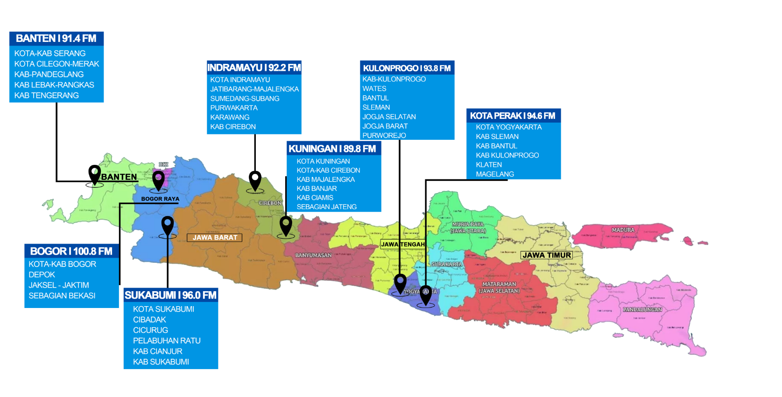
Map Coverage Area Network
Megaswara fm

Slide 3
JUMLAH PENDUDUK/WILAYAH
BOGOR
BANTEN
SUKABUMI
INDRAMAYU
KUNINGAN
KULONPROGO
KOTA PERAK
KOTA
1.010.566 Jiwa
KABUPATEN
5.759.668 Jiwa
12.689.700 Jiwa
KOTA
321.097 Jiwa
KABUPATEN
2.460.693 Jiwa
1.810.000 Jiwa
1.015.000 Jiwa
412.611 Jiwa
3.631.015 Jiwa
Megaswara fm

Slide 4
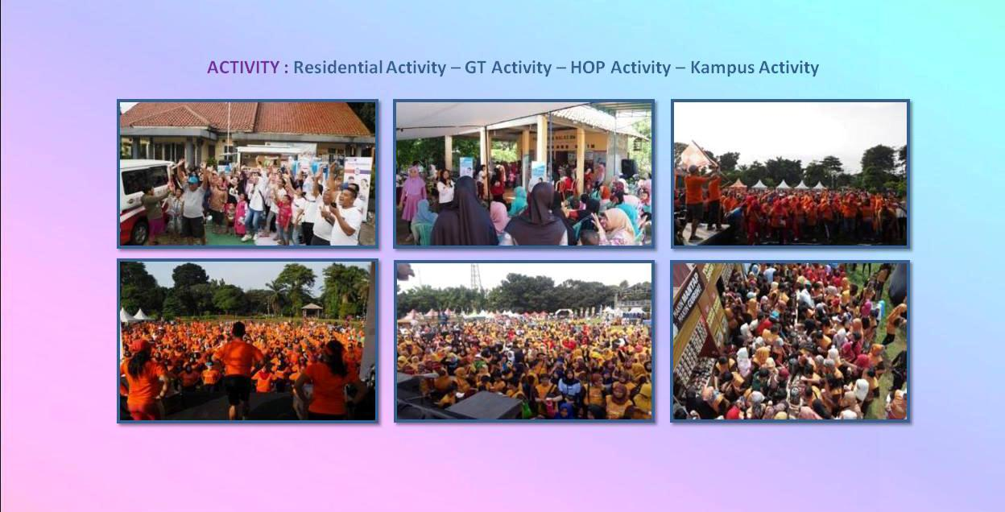
SUKSES EVENT
You can simply impress your audience and add a unique zing and appeal to your Presentations. Easy to change colors, photos and Text. Get a modern PowerPoint Presentation that is beautifully designed. You can simply impress your audience and add a unique zing and appeal to your Presentations. Easy to change colors, photos and Text. Get a modern PowerPoint Presentation that is beautifully designed.
Modern Portfolio Presentation
Megaswara fm

Slide 5


Nama Perusahaan : PT. RADIO CITRA MEGASWARA
Nama Udara : MEGASWARA FM
Alamat : JL. SURYAKENCANA NO.228-230
Email : bogor@megaswara.co.id
NPWP : 01.119.478.4-404.000
No.Rekening : BCA427.300.3099
Frekuensi : 100.8 FM
KOMPOSISI SIARAN
FORMAT MUSIK
Kota & Kab Bogor, Depok
Jaksel – Jaktim, Sebagian Tangerang
Sebagian Bekasi, Karawang
COVERAGE AREA
Head Office :
Gd. UG Multimedia CenterJl. Suryakencana No. 228 230 Bogor 16126, Jawa Barat / Direct Marketing (0251) 8331-425, 8393 379,833787/F
Hunting : (0251) 8439 617, 8349 051
Megaswara fm
www.megaswara.co.id

Slide 6

FORMAT SIARAN & MUSIK
70%
POP INDO 60%
30%
DANGDUT 20%
NEWS
MUSIK
POP BARAT20%
KOMPOSISI SIARAN
FORMAT MUSIK
Head Office :
Gd. UG Multimedia CenterJl. Suryakencana No. 228 230 Bogor 16126, Jawa Barat / Direct Marketing (0251) 8331-425, 8393 379,833787/F
Hunting : (0251) 8439 617, 8349 051
Megaswara fm
www.megaswara.co.id

Slide 7
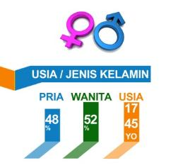
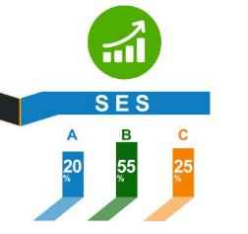
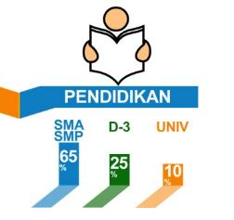

Profile
Pendengar
Head Office :
Gd. UG Multimedia CenterJl. Suryakencana No. 228 230 Bogor 16126, Jawa Barat / Direct Marketing (0251) 8331-425, 8393 379,833787/F
Hunting : (0251) 8439 617, 8349 051
Megaswara fm
www.megaswara.co.id

Slide 8
megaswaraFM
19730
radiomegaswara
7579
megaswaraFM
5258
megaswaranetwork
685
Head Office :
Gd. UG Multimedia CenterJl. Suryakencana No. 228 230 Bogor 16126, Jawa Barat / Direct Marketing (0251) 8331-425, 8393 379,833787/F
Hunting : (0251) 8439 617, 8349 051
Megaswara fm
www.megaswara.co.id

Slide 9
RATE CARD
PRIME TIME
REGULAR TIME
LOOSE SPOT
500.000
400.000
ADLIBS
600.000
500.000
2.000.000
1.500.000
PRIME TIME
REGULAR TIME
INSERT
06:00 s/d 10.00
16:00 s/d 20:00
10:00 s/d 16.00
20:00 s/d 24:00
SPONSOR
PROGRAM /
TALKSHOW
6.000.000
4.000.000
TIME SIGNAL
750.000
500.000
MEDSOS
500.000
250.000
Head Office :
Gd. UG Multimedia CenterJl. Suryakencana No. 228 230 Bogor 16126, Jawa Barat / Direct Marketing (0251) 8331-425, 8393 379,833787/F
Hunting : (0251) 8439 617, 8349 051
Megaswara fm
www.megaswara.co.id

